Slide 1
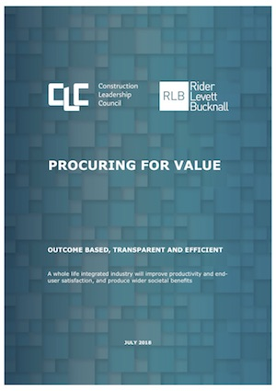
Procuring for Whole Life Value: how do we effect real change?
Edge Debate 85
16th October 2018

Slide 2
Ann Bentley

Slide 3
Clc vision
Three strategic outcomes - delivered through three key enablers

Slide 4
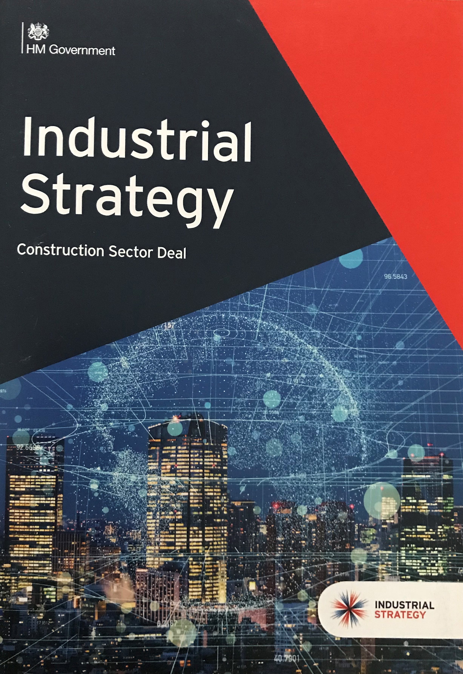
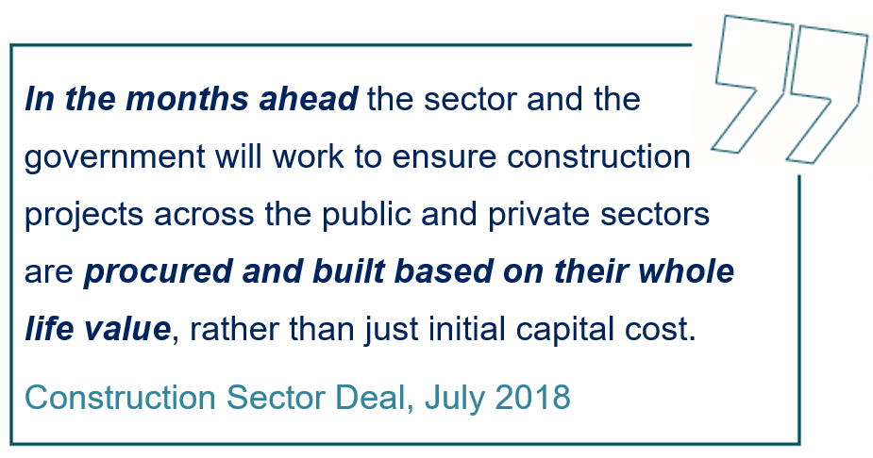
Construction sector deal
The government and the construction sector, through the Construction Leadership Council, have agreed a Sector Deal to transform the productivity of the sector benefiting the wider economy.

Slide 5
deal
Government Action | Sector Action
Improve the lifetime performance of buildings, through better procurement: | Improve the lifetime performance of buildings, through better procurement:
Embed ‘procure for value’ approach in public procurement and build capability to do this through the Infrastructure Projects Authority (IPA) and government departments across Whitehall. | Develop an industry wide definition of value which takes into account more than capital cost. Produce a universally applicable methodology for procurement and promote common and consistent standards across industry.

Slide 6
Procuring for value - themes
PROCURING FOR VALUE
Theme 1: Client Pull – Outcome Based Procurement
Theme 2: Increase Transparency on the Performance of Suppliers and Assets
Theme 3: Supplier Push – Improve Procurement Efficiency and ‘Get the Basics Right’
Notes:
1. Use outcome based procurement to drive capital programme delivery and lifetime performance. To do this, models of value must be defined which are broader than capital cost.
2. The industry has become so entrenched in minimising the capital cost of the built asset that little attention is given to the performance of either suppliers or assets.
3 Whilst clients are often unhappy about the performance of the sector, there are also compelling supply-side issues around risk, profit and uncertainty.

Slide 7
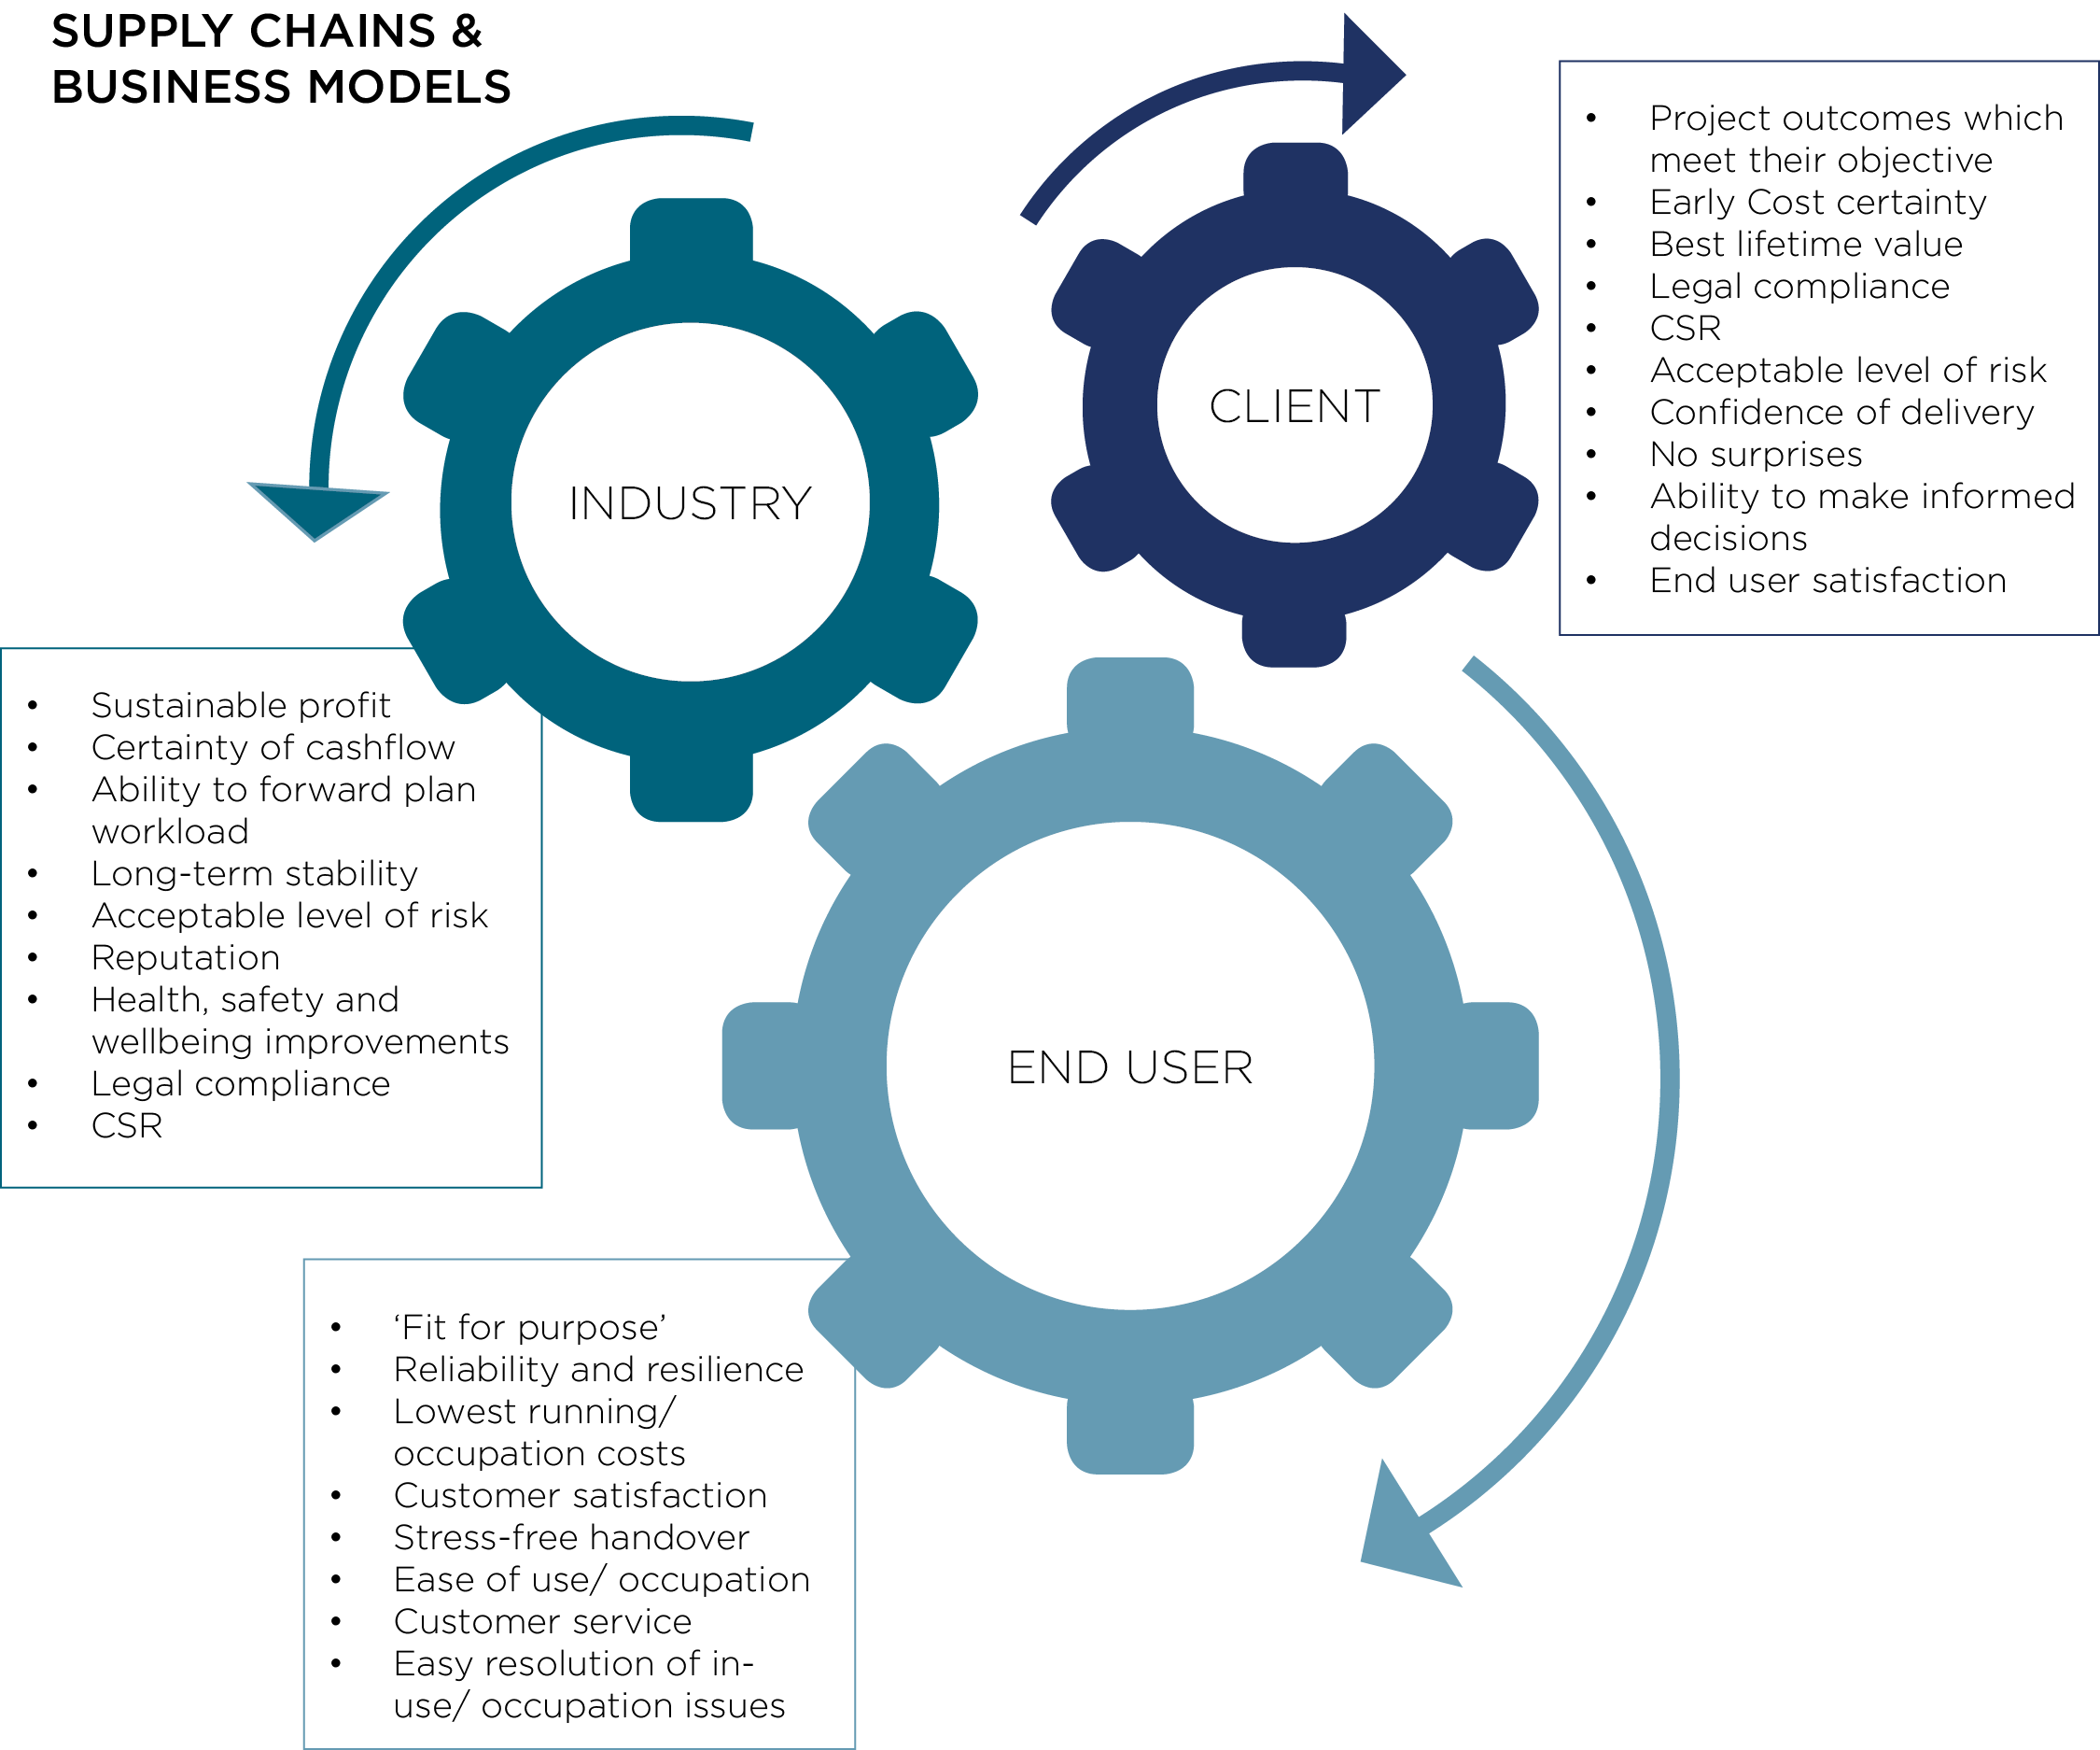
Un-aligned objectives

Slide 8
Client pull - Outcome based procurement
Procurement Behaviours
Predictability
The Value Model
To drive capital programme delivery and lifetime performance.

Slide 9
The value model - What is value?
Capital cost effectiveness
Whole-life value
Capital and Operational Carbon Emissions
Digital effectiveness, BIM and data capture
Use of standard components and pre-manufactured value
Design Quality Indicators
Collaborative behaviour and supply-chain integration
Government Soft Landing
Social Value of the construction process
Health, Safety and Well-being during construction
R&D and Innovation

Slide 10
Calculating value
VALUE ELEMENTS
Ref | Question | How can the design/ construction process influence this? | What is the Cost driver? | Cost £,000 | When do we measure the Cost/Value Metric? | Do we have a Value Metric? | Value? £,000 | Incentive / Penalty | Comments
1 | WHOLE LIFE VALUE
1.1 | Outcome Metrics
 | What will the measure of success by when the asset/building is in use?
1.1.1 | Educational performance | Design developed from case-studies and best practice of what worked in the past | Extra-over cost compared to a school which is simply compliant with current standards and guidance. Say - 10% additional design cost but no extra construction cost | £400 | Cost - during the design period, at tender and PC. Value would be after 5 years. | GMCA - saving to the treasury per pupil per year. | £1,966 | Designer | Improved educational attainment can be valued - this would have to be measured over the full 5 year period. How much could be put down to good design and how much would be to do with teaching and management? Would also need original base-line attainment for a school in that area with that demographic.

Slide 11
Louise Lado-Byrnes

Slide 12
Kevin Murray

Slide 13
CCS Offering to support Procuring for Value
The Opportunity
The Issue
The Outcome
The public sector is the largest single client
Addressable spend – circa £30bn per annum
Government policy and government construction strategy drivers
This first generation CCS Construction Framework - Forecast spend up to 2022 circa £3.25bn
Circa 25 CG and PBO frameworks, 8,000+ WPS Contracts* and individual OJEUs service the spend. Leading to disaggregated spend , there is a lack of commercial leverage, different terms and conditions, costs to service are high (market and public sector)
Supplier failure – Carillion
Construction is an occasional buy for some WPS organisations
There is poor supplier oversight
There are poor practices, poor asset records and some organisations are ill equipped to procure construction
There is an absence of MI to gauge compliance and drive improvement
* further work needed to identify the scale of contracting within WPS
Complete asset lifecycle for built asset requirements –enables whole life assessments to be made and drive improved value for money for the tax payer
The utilisation of a framework alliance approach
To harness harness the collective skills and experience of appointed supplier to drive innovation and vfm
to support a more structured approach to the commissioning and delivery of requirements
Reduce the number of routes to service the spend - demand is channelled, vfm leveraged, consistent terms and conditions, cost to serve reduced
More data on suppliers across public sector users
Better management information and asset records will support the development of Intelligent Client Functions
Improved supplier oversight to enable earlier corrective action
Support implementation and measurement of government policy and construction strategies - help the IPA to measure success (e.g. SMEs, fair payment, social value) and to indicate where re-calibration and/or further targeted support to CG is required
Drive vfm for the taxpayer from the synergies that will derive from closer working between contracting authorities, construction consultants engaged by CG/WPS, contractors appointed to the framework and their supply chain
DRIVERS FOR
CHANGE:
1. Consolidation
2. Efficiency
3. Policy
4. Capability
5. Transparency
6. Risk

Slide 14
High Level Ten Year Plan
17/18
18/19
19/20
20/21
21/22
22/23
23/24
24/25
26/27
27/28
28/29
Now
£1.5bn per annum
Works
Best in Class Agreements
Option to extend
Engagement
Develop Best in Class
Best in Class Agreements inc Construction and Operation
TBA
Construction Products
Standard Frameworks
Best in Class Agreements
Option to extend
Best in Class Agreements across Products/Off –site and Modular
£6m per annum
Off Site Construction
Engagement
Develop Best in Class
Engagement
Develop Best in Class
£2m per annum
Modular
Best in Class Framework
£225m - £400m per annum
Services
Standard Framework
Engagement
Develop best in class
Best in class agreements
Engagement
Develop Best in Class
Best in class agreements
Engagement
Develop best in class
£ per annum
Fit Out
Best In Class Framework
Subsumed into Best In Class Works Agreements

Slide 15
Contract Structure
CCS Framework Management requirements
FAC – 1
CCS core T&C requirements
Scheduled permissible call-off contracts
(mini-tender or direct award)
Call off arrangements etc
JCT
variants
NEC
variants
PPC2000 variants
Standard Boilerplate amendments
Project / Customer specific amendments

Slide 16
Alan Crane

